Slide 1
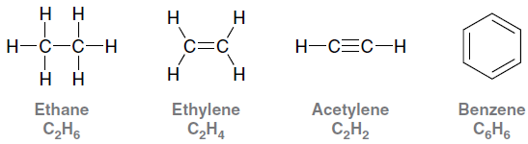
4.1 Alkanes
Hydrocarbons are compounds that are only composed of hydrogen and carbon.
Which of the molecules above is saturated with hydrogen atoms?

Slide 2

4.1 Alkanes
Saturated hydrocarbons do NOT contain any pi bonds.
When communicating about molecules, each unique molecule must have a unique name.
  The suffix ane is used for saturated hydrocarbons.
How are the above hydrocarbons different?

Slide 3
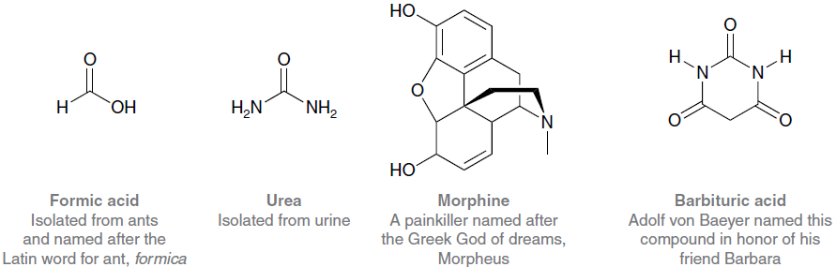
4.2 Naming Compounds – Alkanes
Many organic compounds have common names.
Some common names have been used for hundreds of years and are still frequently used.

Slide 4
4.2 Naming Compounds – Alkanes
In 1892, as the number of known molecules grew, chemists decided that a SYSTEMATIC naming system was needed.
  IUPAC (International Union of Pure and Applied Chemistry) system
We can learn the IUPAC system instead of having to memorize a common name for every molecule.

Slide 5
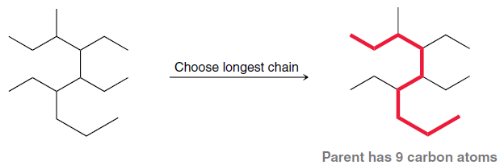
4.2 Naming Compounds – Alkanes
Finding The Parent Chain
The IUPAC system:
  Find the parent chain, the longest consecutive chain of carbons.

Slide 6
4.2 Naming Compounds – Alkanes
Finding The Parent Chain
Find the parent chain, the longest consecutive chain of carbons.
Use Table 4.1 to look up the prefix that corresponds
to the number of carbons in the parent chain.

Slide 7
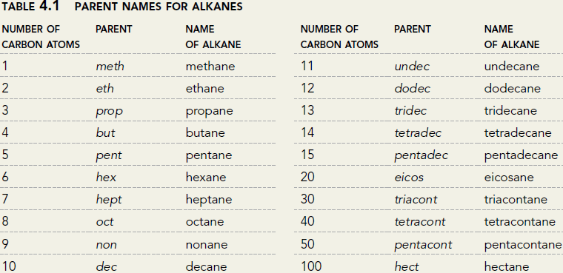
4.2 Naming Compounds – Alkanes
Finding The Parent Chain
Use Table 4.1 to look up the prefix that corresponds
to the number of carbons in the parent chain.

Slide 8
4.2 Naming Compounds – Alkanes
Finding The Parent Chain
Find the parent chain, the longest consecutive chain of carbons.
  If the parent chain has 9 carbons, the parent name is nonane.
  It would be smart to memorize the names for chains 1 to 10 carbons in length.
  Use Table 4.1 to look up the prefix that corresponds with the number of carbons in the parent chain.

Slide 9
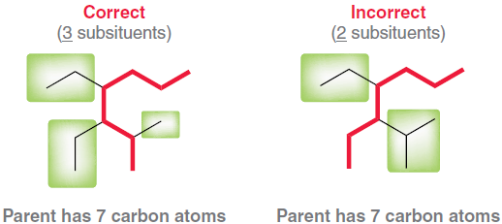
4.2 Naming Compounds – Alkanes
Finding The Parent Chain
Find the parent chain, the longest consecutive chain of carbons.
  If there is more than one possible parent chain, choose the one with the most substituents (side chains) attached .
What is the parent name for this compound?

Slide 10

4.2 Naming Compounds – Alkanes Finding The Parent Chain
Find the parent chain, the longest consecutive chain of carbons.
  If the parent chain is cyclic (a ring of carbons), add the prefix, “cyclo” to the beginning of the parent name.
Practice with SKILLBUILDER 4.1.

Slide 11
4.2 Naming Compounds – Alkanes
Finding The Parent Chain
Find the parent chain, the longest consecutive chain of carbons.
  Give the parent name for the following compounds.
  The parent name may NOT include carbons that are both in a ring and outside a ring. Find the IMPROPER.
  9-carbon chain in one of the molecules above.

Slide 12
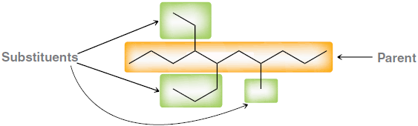
4.2 Naming Compounds – Alkanes
Identifying Substituents
Identify and name substituents (side chains).
  Count the number of carbons in each side group, and use the terms from Table 4.2 to name the substituents.
  The terms in Table 4.2 are the same as those in Table 4.1, except they end in “yl” instead of “ane.”
  Name the parent and substituents above.

Slide 13
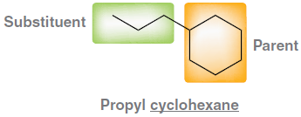
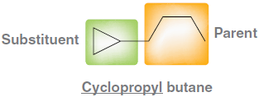
4.2 Naming Compounds – Alkanes
Identifying Substituents
Identify and name substituents (side chains).
  A ring can be either a parent chain or a substituent depending on the number of carbons.
Practice with SKILLBUILDER 4.2.

Slide 14
4.2 Naming Compounds – Alkanes
Identifying Substituents
Identify and name substituents (side chains).
  Name the substituents in the following molecules.

Slide 15
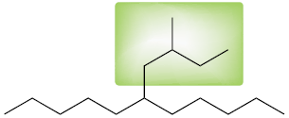
4.2 Naming Compounds – Alkanes
Identifying Substituents
Identify and name substituents (side chains).
  Some substituents have complex branches.
  How many carbons are in the highlighted substituent above?
  Why is it improper to name it a PENTYL group?

Slide 16
4.2 Naming Compounds – Alkanes
Identifying Substituents
Identify and name substituents (side chains).
  For substituents with complex branches:
    Number the longest carbon chain WITHIN the substituent. Start with the carbon directly attached to the main chain.
    Name the substituent (in this case butyl).
    Name and number the substituent’s side group (in this case 2-methyl).
  The name of the substituent is (2-methylbutyl).
2
4
1
3

Slide 17
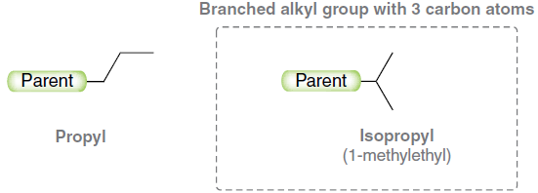
4.2 Naming Compounds – Alkanes
Identifying Substituents
Identify and name substituents (side chains).
  Some branched substituents have COMMON names that you may want to memorize, because they are used more frequently than their IUPAC names.

Slide 18
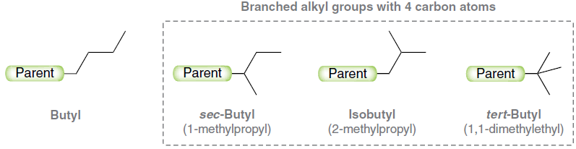
4.2 Naming Compounds – Alkanes
Identifying Substituents
Identify and name substituents (side chains).
  Some branched substituents have COMMON names that you may want to memorize, because they are used more frequently than their IUPAC names.

Slide 19
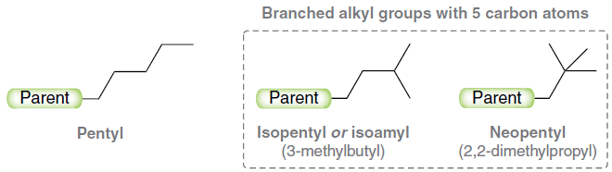
4.2 Naming Compounds – Alkanes
Identifying Substituents
Identify and name substituents (side chains).
  Some branched substituents have COMMON names that you may want to memorize, because they are used more frequently than their IUPAC names.
Practice with SKILLBUILDER 4.3.

Slide 20
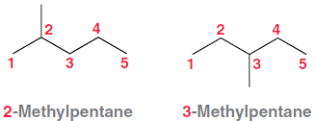
4.2 Naming Compounds – Alkanes
Numbering the Parent Chain
Number in sequence the consecutive carbons in the parent chain and assign a locant to each substituent.
  The number or LOCANT is used to communicate where each substituent is attached to the parent chain.
The molecules above are isomers, and they have the same parent name. Their full name must
differ though, because they are not identical.

Slide 21
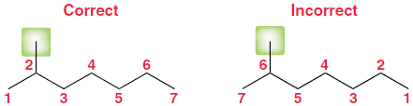
4.2 Naming Compounds – Alkanes
Numbering the Parent Chain
Guidelines to follow when numbering the parent chain:
  If ONE substituent is present, number the parent chain so that the substituent has the lowest number possible.

Slide 22
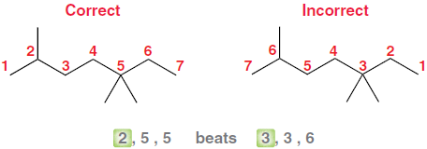
4.2 Naming Compounds – Alkanes
Numbering the Parent Chain
Guidelines to follow when numbering the parent chain:
  When multiple substituents are present, number the parent chain to give the first substituent the lowest number possible.

Slide 23
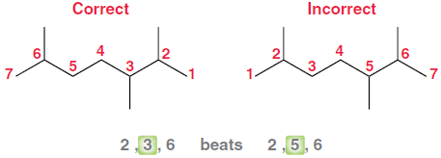
4.2 Naming Compounds – Alkanes
Numbering the Parent Chain
Guidelines to follow when numbering the parent chain:
  If there is a tie, then number the parent chain so that the second locant gets the lowest number possible.

Slide 24
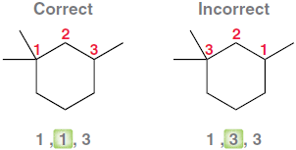
4.2 Naming Compounds – Alkanes
Numbering the Parent Chain
Guidelines to follow when numbering the parent chain:
  The same rules apply for cycloalkanes.

Slide 25
4.2 Naming Compounds – Alkanes
Assembling The Entire Name
Guidelines to follow when numbering the parent chain
  To assemble the complete name, assign a locant to each substituent, and list them before the parent chain name in alphabetical order
  A prefix is used (di, tri, terta, penta, etc.) if multiple substituents are identical
  Prefixes are NOT used for alphabetical purposes, except for the prefix “iso”
Name the cycloalkanes:

Slide 26
4.2 Naming Compounds – Alkanes Summary
Identify the parent chain, the longest consecutive chain of carbons.
Identify and name substituents (side chains).
Number the parent chain and assign a locant (and prefix if necessary) to each substituent.
  Give the first substituent the lowest number possible.
List the numbered substituents before the parent chain name in alphabetical order.
  Ignore prefixes (except iso) when ordering alphabetically.
Practice with SKILLBUILDER 4.4.

Slide 27
4.2 Naming Compounds – Alkanes Summary
Name the following molecule.
Draw the bond-line representation for 1-tert-butyl-2-ethyl-4-methyl-3-cyclopentylcyclohexane.

